Slide 1
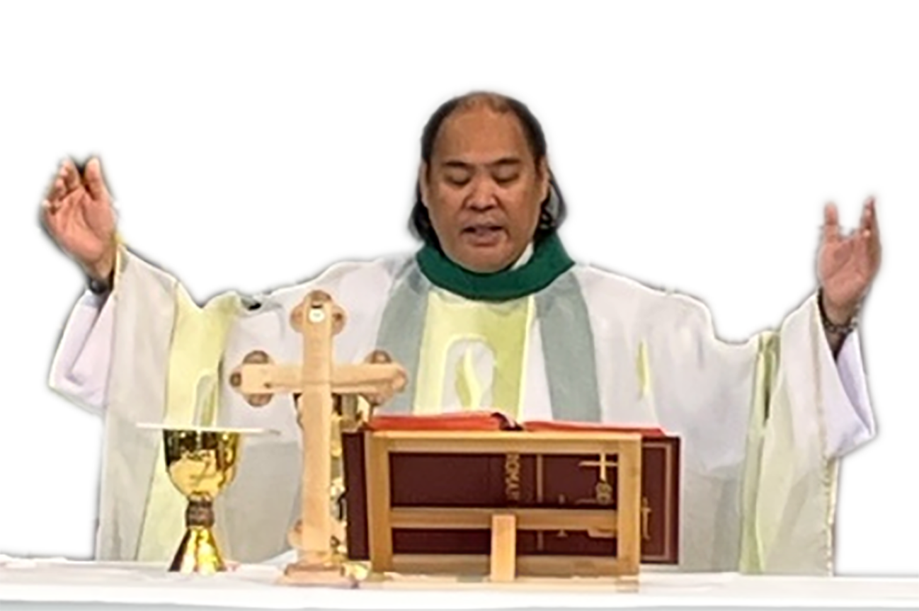
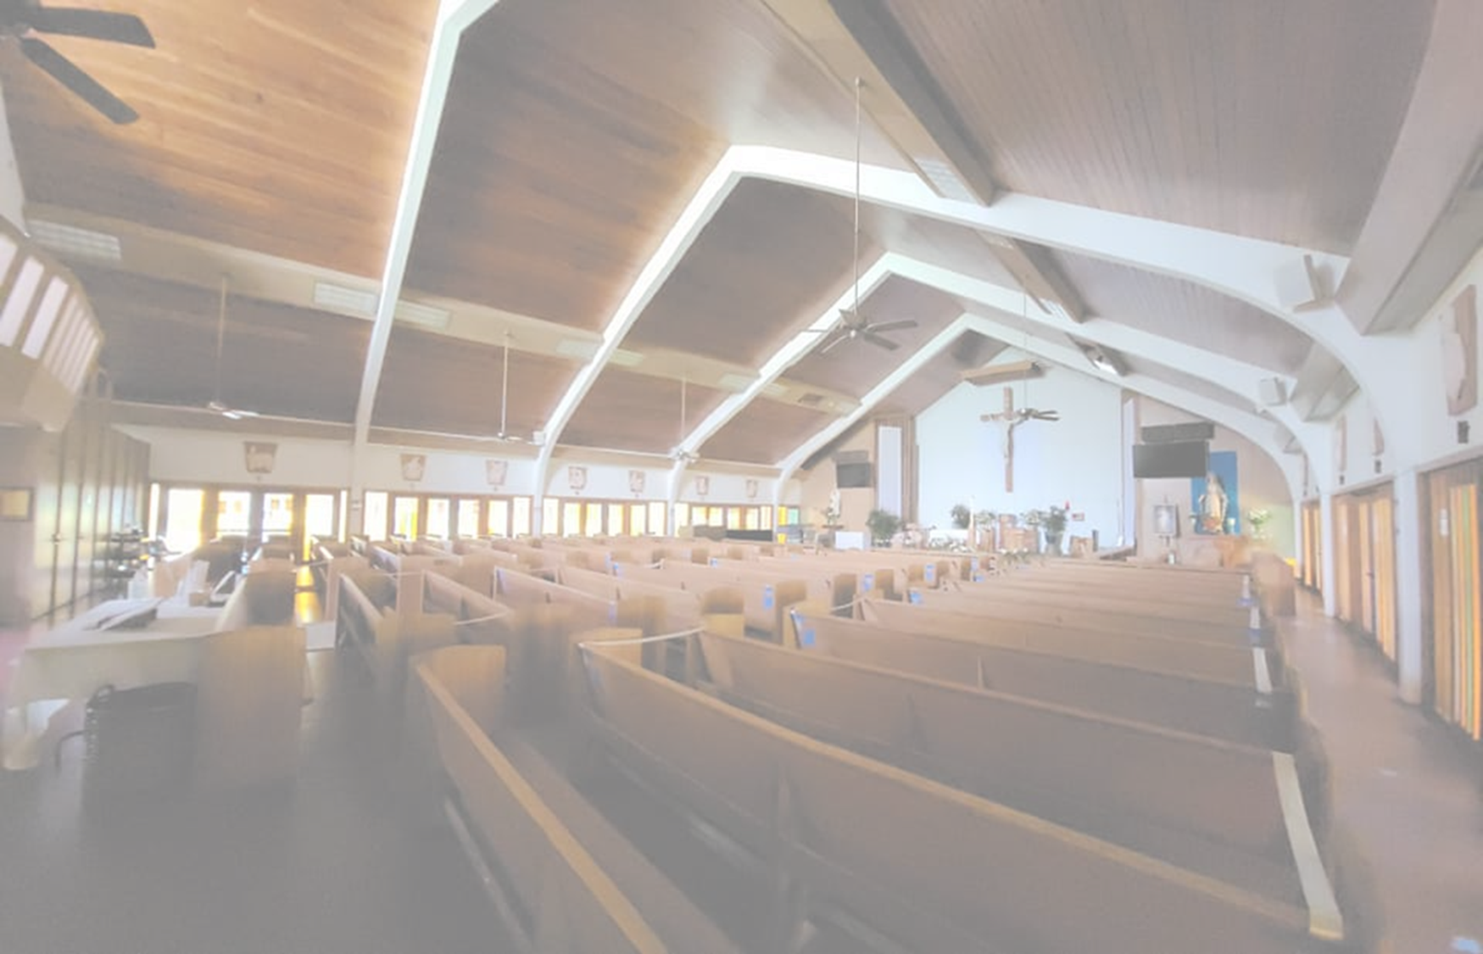
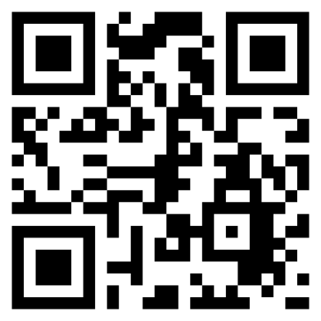
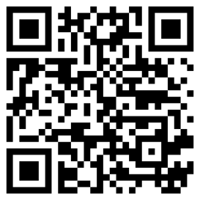
SUNDAY Mass Schedule
Saturday Vigil - 4:00 pm
(Confession - 3:00 pm)
Sunday - 8:30am & 11:30am
PRAISE AND WORSHIP MUSIC 11:00am
DAILY Mass Schedule
Mon – Thur & Saturday
Rosary 6:55am
Mass - 7:25am
Closed on Fridays
St. Pius X Church
2821 Lowrey Ave. Honolulu (Manoa) HI. 96822
Fr. Nicholas
Brown(Celebrant)
SIGN UP &
MESSAGE US
(808) 988-3308
PRAYER REQUESTS
TEXT (808)943-7088
Notes:
1

